Slide 1
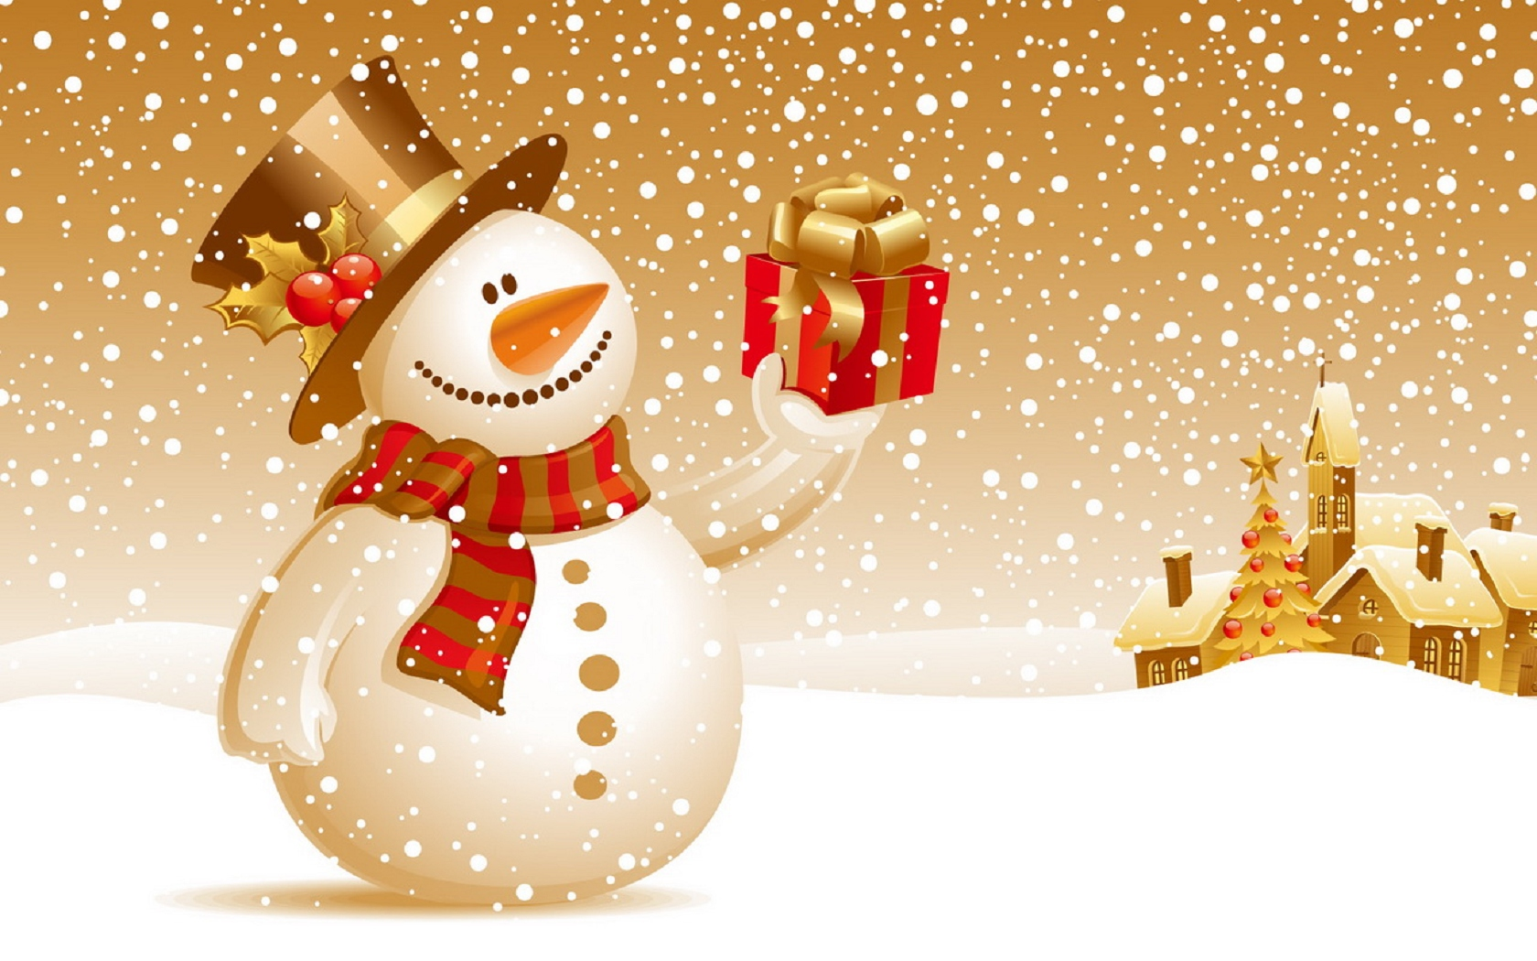
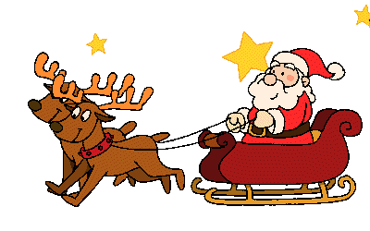
christmas

Slide 2
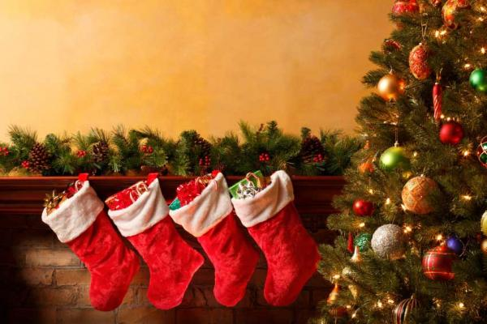
Customs

Slide 3
Christmas is one of the most important and popular day in the whole year. People are kind and they spend time with their families. Children dress the Christmas tree and wait for the presents.
The tradition tells that there should be twelve dishes on the table. People start eating when the first star is on the sky.
In the middle of the night there is a special event called Midnight Mass.
People go to the church and sing carols. Carols are the songs about Jesus and His birth.

Slide 4
Before Christmas people decorate their houses in red and green, hang mistletoe on the door, dress Christmas trees, send Christmas cards and listen to the famous Christmas Carols and songs.

Slide 5
In the UK, Christmas begins on December 24. However, in contrast to the Polish tradition, this day is not so family and symbolic. On Christmas Eve children hang the stockings for Santa Claus and wait for gifts! Kids leaves Santa a glass of milk and cookies and also carrot for his reindeers.
December 25, Christmas Day, the entire British family gathers for dinner, they eat roast turkey and Christmas pudding for dessert.
December 26 is called Boxing Day. The name of the holiday comes from the word ‚box’ and is a day of giving presents.

Slide 6
The most popular carol sand by English people is
„Good King Wencelas”.

Slide 7
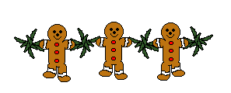
Small glossary of Christmas

Slide 8
ANGEL – Anioł
CANDLE – Świeczka
CHRISTMAS CAROL - Kolęda
CHRISTMAS CRIB - Szopka
CHRISTMAS EVE – Wigilia
CHRISTMAS GREETINGS CARD – Kartka z życzeniami
CHRISTMAS GREETINGS – Życzenia Świąteczne
CHRISTMAS MIDNIGHT MASS - Pasterka
CHRISTMAS TREE – Choinka :
• BELL - dzwoneczek
• CANDY - cukierek
• CHAIN - łańcuch
• GLASS BALL - bombka
• LIGHTS – światełka na choinkę

Slide 9
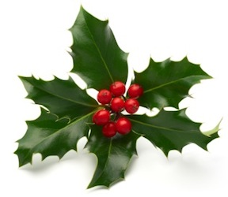
ELF - Elf
THE FIRST STAR – Pierwsza Gwiazdka
GIFT / PRESENT - Prezent
MISTLETOE - Jemioła
REINDEER - Renifer
SANTA CLAUSE / FATHER CHRISTMAS – Święty Mikołaj
STOCKING - Skarpeta na prezenty
WAFER – Opłatek

Slide 10
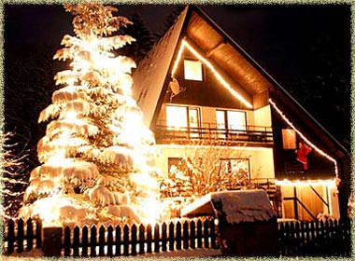
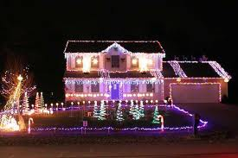
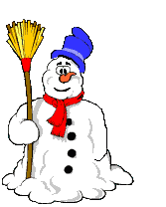
Christmas Decorations ...

Slide 11
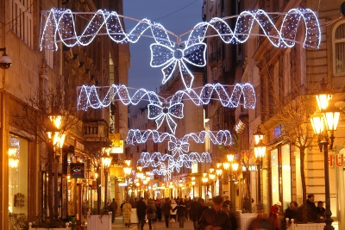
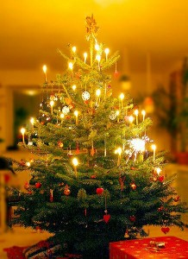

Slide 12
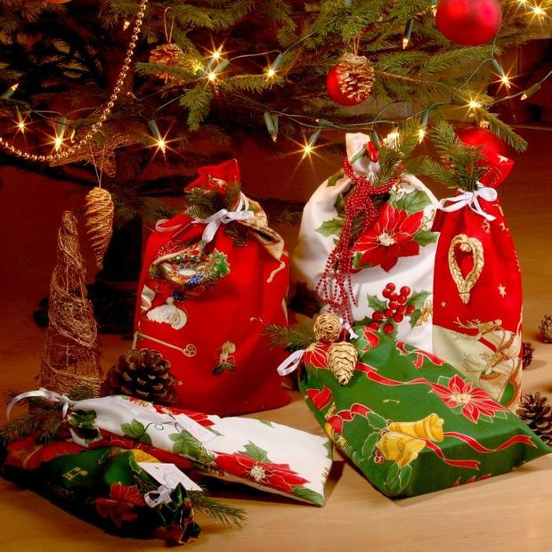
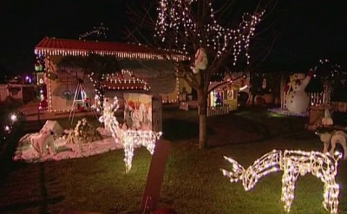
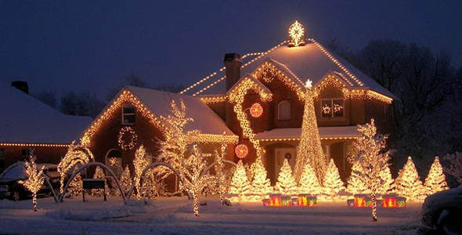

Slide 13
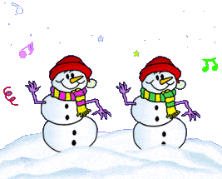
The End ☺
Alicja Gubernat Kl. V

