Slide 1
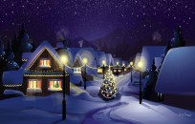
Christmas

Slide 2
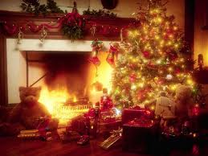
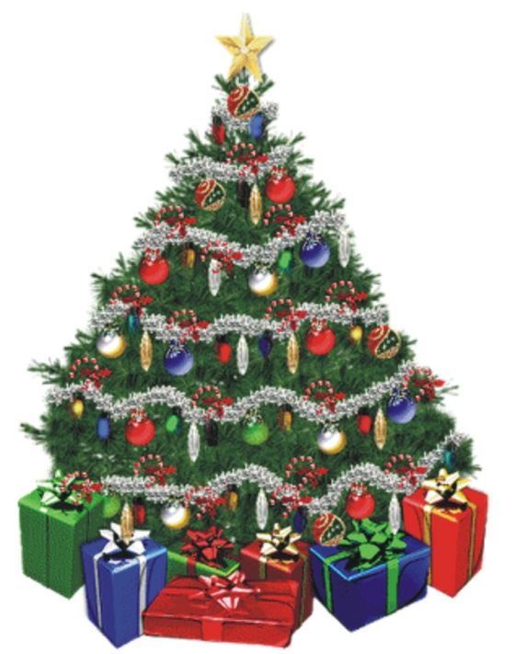
Christmas is a celebration of the birth of Jesus Christ, celebrated generally on December 25 by millions of people around the world.

Slide 3
Dictionary- słownik
Christmas tree- choinka
Santa Claus- święty Mikołaj
Snowman- bałwan
Angel- anioł
Star- gwiazda
Reindeer-renifer
Sleigh- sanie
Presents- prezenty

Slide 4
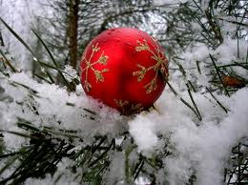
Christmas is the time that we spend together with family and friends.
Beautiful time of peace and happiness.

Slide 5
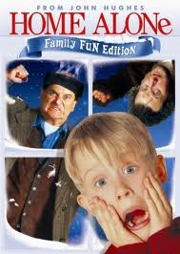
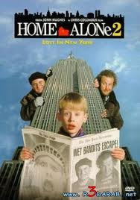
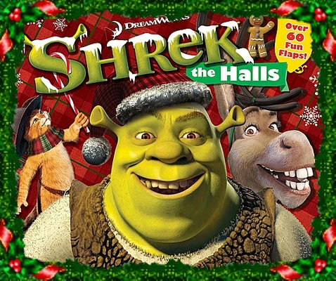
A lot of movies have been recorded about Christmas

Slide 6
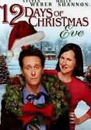
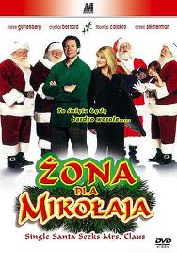
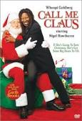
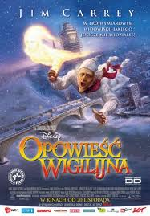
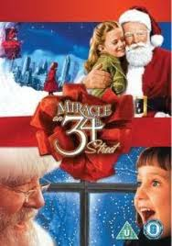
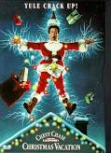

Slide 7
THE END
Merry Christmas and Happy New Year!
Projekt wykonała Wiktoria Wasiak kl. V

